Slide 1
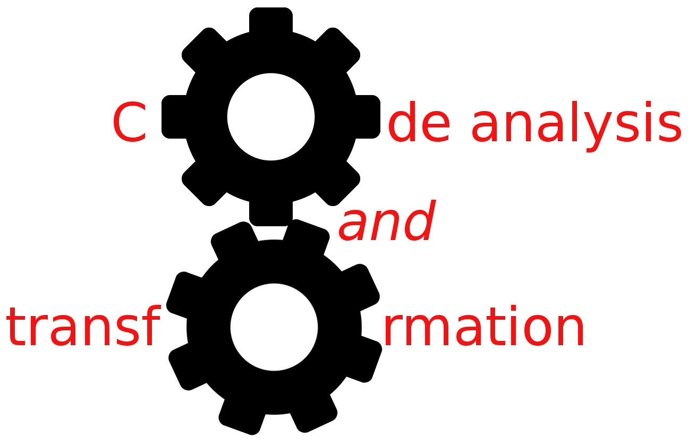


A research CAT
Simone Campanoni simonec@eecs.northwestern.edu

Slide 2
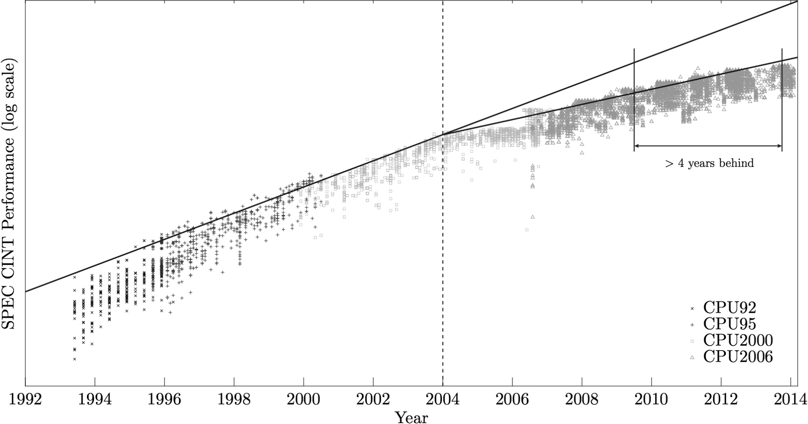
Sequential programs are not accelerating like they used to
Performance gap
Performance (log scale)
Core frequency scaling
Multicore era
Sequential program running on a platform
1992 2004

Slide 3
Multicores are underutilized
Single application: Not enough explicit parallelism
Developing parallel code is hard
Sequentially-designed code is still ubiquitous
Multiple applications: Only a few CPU-intensive applications running concurrently in client devices

Slide 4
Parallelizing compiler: Exploit unused cores to accelerate sequential programs

Slide 5
Non-numerical programs need to be parallelized
Non-numerical programs
Numerical programs

Slide 6
Parallelize loops to parallelize a program
Outermost loops
99% of time is spent in loops
Time

Slide 7
DOACROSS parallelism
Iteration 0
work()
Iteration 1
work()
Iteration 2
work()

Slide 8
DOACROSS parallelism
Sequential segment
c=f(c)
d=f(d)
work()
c=f(c)
d=f(d)
work()
c=f(c)
d=f(d)
work()
Parallel segment

Slide 9

HELIX: DOACROSS for multicore
[Campanoni et al, CGO 2012, Campanoni et al, DAC 2012, Campanoni et al, IEEE Micro 2012]
c=f(c)
d=f(d)
work()
c=f(c)
d=f(d)
work()
c=f(c)
d=f(d)
work()

Slide 10
HELIX: DOACROSS for multicore
[Campanoni et al, CGO 2012, Campanoni et al, DAC 2012, Campanoni et al, IEEE Micro 2012]
c=f(c)
d=f(d)
work()
c=f(c)
d=f(d)
work()
c=f(c)
d=f(d)
work()

Slide 11
HELIX: DOACROSS for multicore
[Campanoni et al, CGO 2012, Campanoni et al, DAC 2012, Campanoni et al, IEEE Micro 2012]
Wait 0
Seq. Segment 0
Signal 0
c=f(c)
d=f(d)
work(x)
c=f(c)
d=f(d)
work()
Signal 1
Wait 1
c=f(c)
d=f(d)
work()
Seq. Segment 1

Slide 12
HELIX: DOACROSS for multicore
[Campanoni et al, CGO 2012, Campanoni et al, DAC 2012, Campanoni et al, IEEE Micro 2012]

Slide 13
HELIX: DOACROSS for multicore
[Campanoni et al, CGO 2012, Campanoni et al, DAC 2012, Campanoni et al, IEEE Micro 2012]

Slide 14
Parallelize loops to parallelize a program
Outermost loops
Innermost loops
99% of time is spent in loops
Time

Slide 15
Parallelize loops to parallelize a program
Innermost loops
Outermost loops
Coverage
HELIX
Ease of analysis
Communication

Slide 16

HELIX: DOACROSS for multicore
16
[Campanoni et al, CGO 2012, Campanoni et al, DAC 2012, Campanoni et al, IEEE Micro 2012]
Innermost loops
Outermost
loops
Coverage
HELIX
HELIX-RC
HELIX-UP
Easy of analysis
4
HELIX
Small Loop Parallelism
Speedup
ICC, Microsoft Visual Studio,DOACROSS
Communication
1
SPEC INT baseline
4-core Intel Nehalem

Slide 17
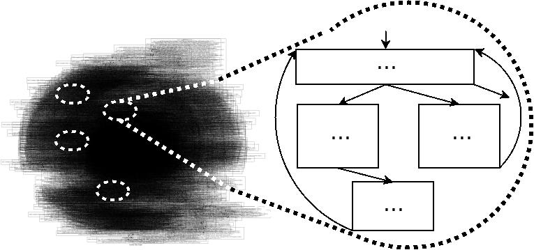
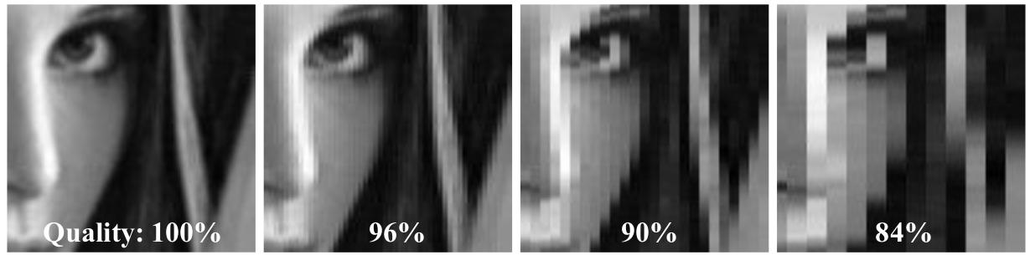
Outline
Small Loop Parallelism and HELIX
HELIX-RC: Architecture/Compiler Co-Design
HELIX-UP: Unleash Parallelization
[CGO 2012 DAC 2012, IEEE Micro 2012]
[ISCA 2014]
Small loops
HELIX
Communication
[CGO 2015]

Slide 18
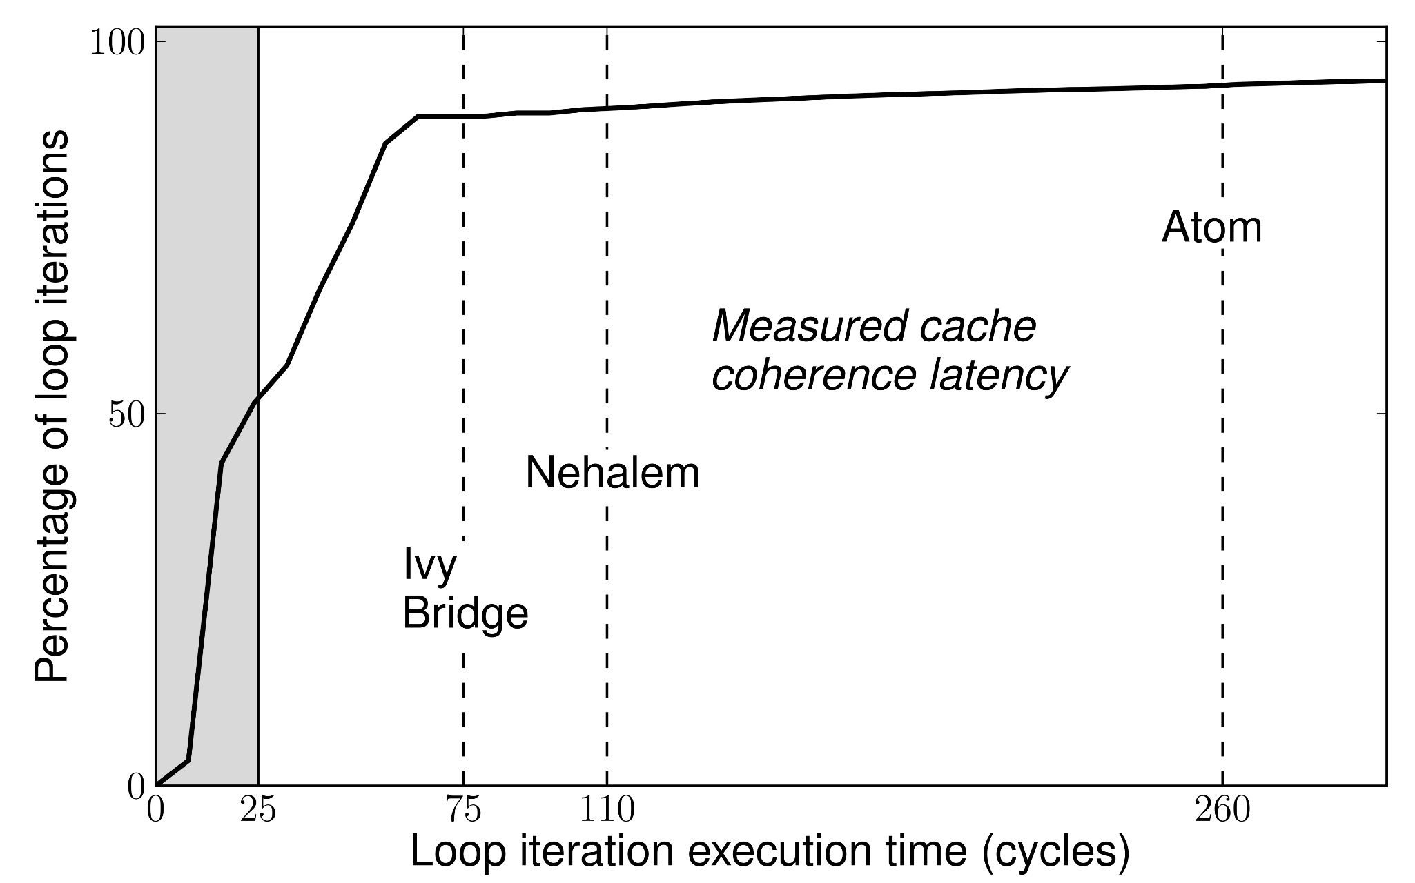
SLP challenge: short loop iterations
SPEC CPU Int benchmarks
Clock cycles
Duration of loop iteration (cycles)

Slide 19
SLP challenge: short loop iterations
90
SPEC CPU Int benchmarks
Clock cycles
Duration of loop iteration (cycles)

Slide 20
SLP challenge: short loop iterations
Adjacent core communication latency
Clock cycles
Duration of loop iteration (cycles)

Slide 21
A compiler-architecture co-design to efficiently execute short iterations
Compiler
Identify latency-critical code in each small loop
Code that generates shared data
Expose information to the architecture
Wait 0
Seq. Segment 0
Signal 0
Architecture: Ring Cache
Signal 1
Reduce the communication latency on the critical path
Wait 1
Seq. Segment 1

Slide 22
Light-weight enhancement of today’s multicore architecture
Store X, 1
Store Y, 1
Iter. 0
Core 0
Core 1
…
Load Y …
Iter. 1
Store X, 1
Load X
Ring node
Ring node
DL1
DL1
Last level cache
DL1
DL1
Store Y, 1
Iter. 3
75 – 260 cycles!
Store Y, 1
Iter. 2
Ring node
Ring node
Core 3
Core 2

Slide 23
Light-weight enhancement of today’s multicore architecture
Store X, 1
Wait 0 Store Y, 1
Signal 0
Iter. 0
Core 0
Core 1
…
Wait 0
Load Y …
Iter. 1
Ring node
Ring node
Ring node
Ring node

Slide 24
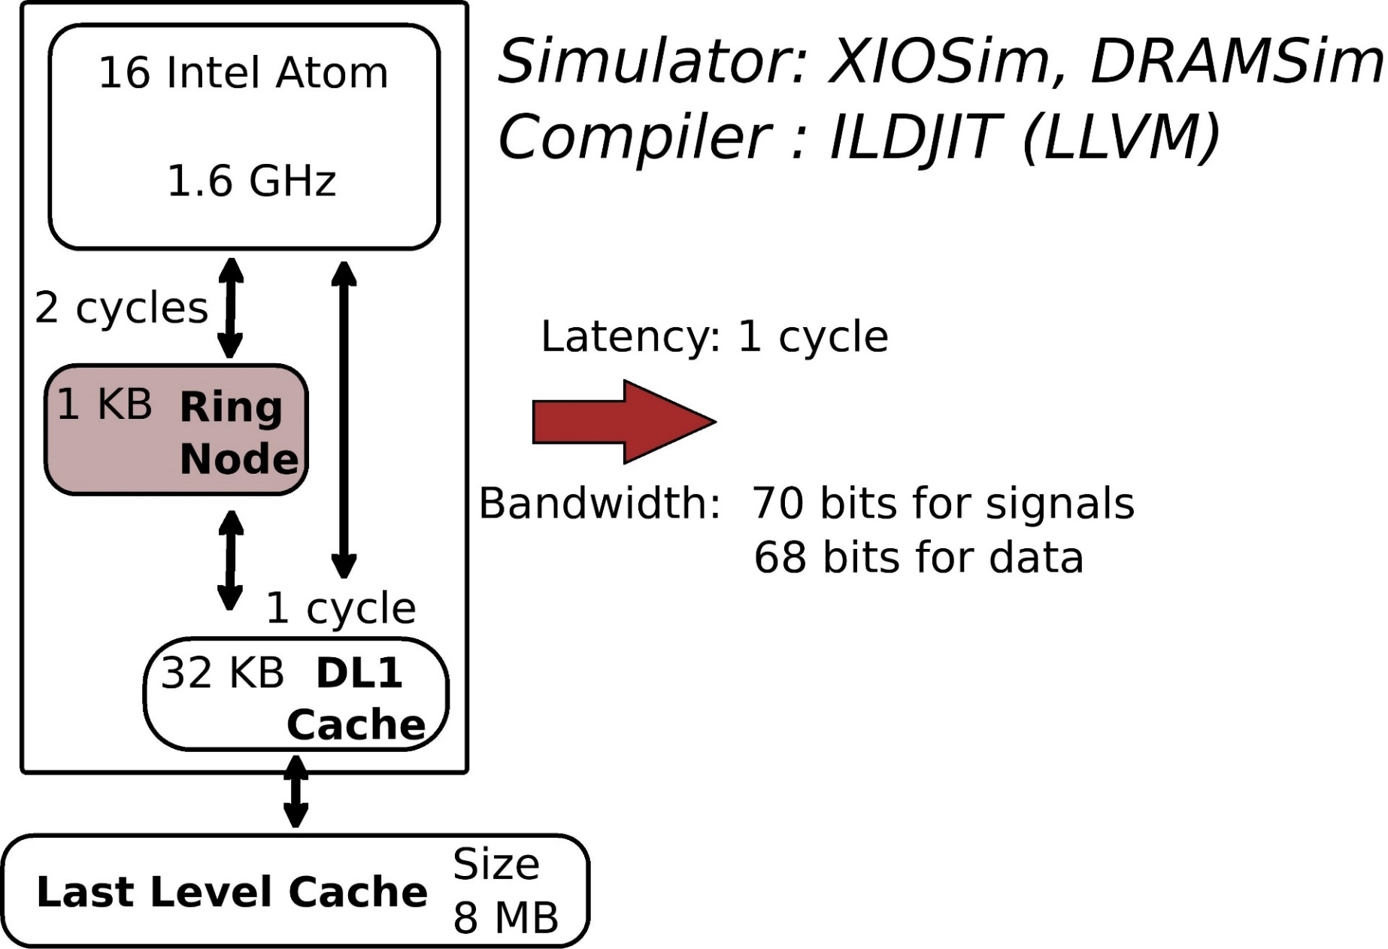
98% hit rate

Slide 25
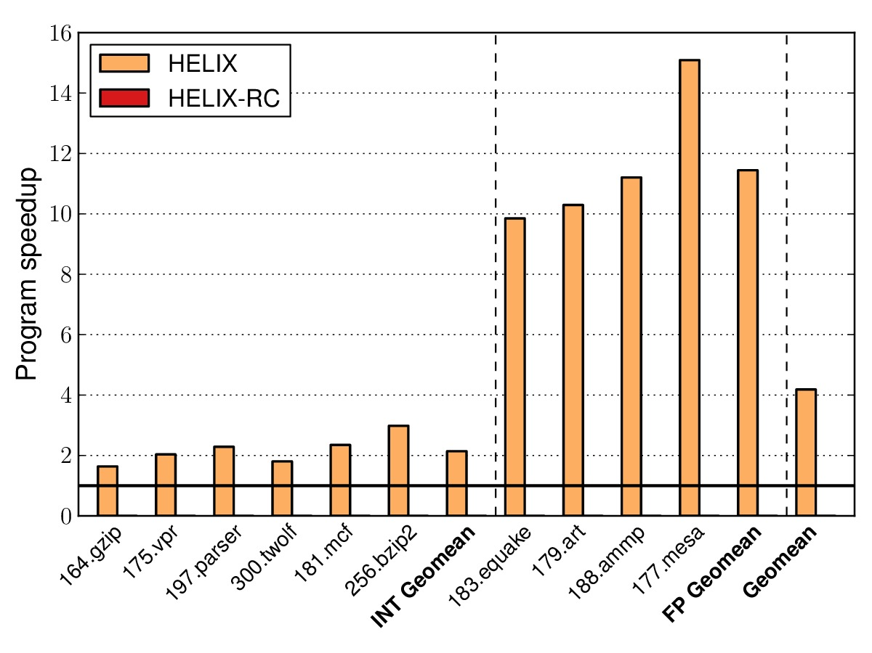
The importance of HELIX-RC
Numerical programs
Non-numerical programs

Slide 26
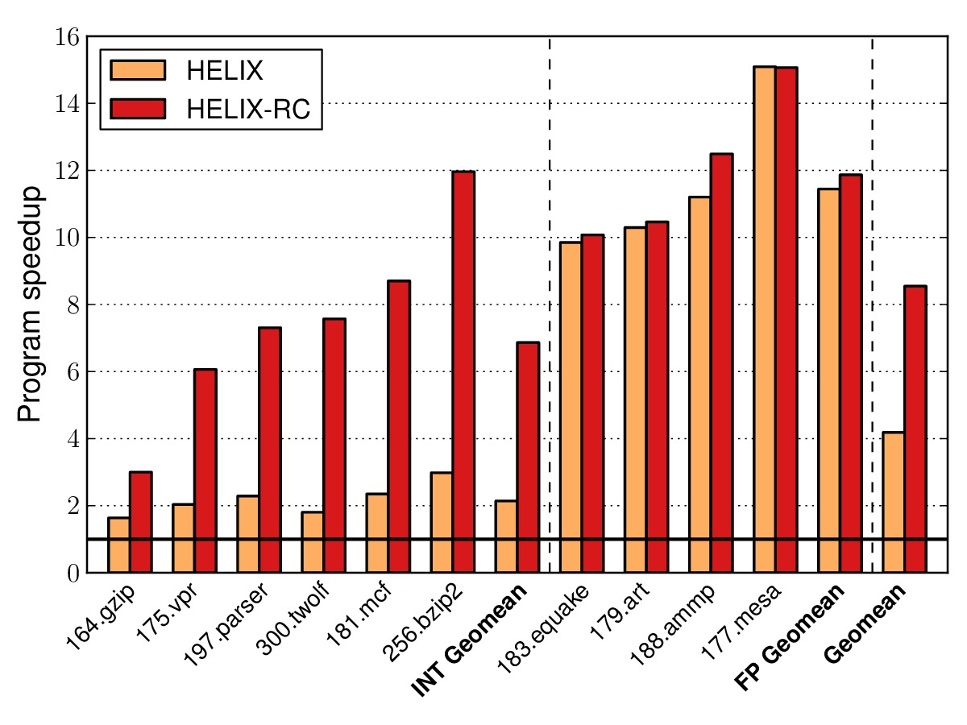
The importance of HELIX-RC
Numerical programs
Non-numerical programs

Slide 27
Outline
Small Loop Parallelism and HELIX
HELIX-RC: Architecture/Compiler Co-Design
HELIX-UP: Unleash Parallelization
[CGO 2012 DAC 2012, IEEE Micro 2012]
[ISCA 2014]
Small loops
HELIX
Communication
[CGO 2015]

Slide 28
HELIX and its limitations
Thread 0
Thread 1
Thread 2
Thread 3
Iteration 0
80%
Data
Iteration 1
Data
Iteration 2
Data
50%
78% accuracy
1.19
Performance:
Lower than you would like
Inconsistent across architectures
Sensitive to dependence analysis accuracy
What can we do to improve it?
79% accuracy
1.61
Nehalem
2.77
Bulldozer
2.31
Haswell
1.68
4 Cores
28

Slide 29
Opportunity: relax program semantics
Some workloads tolerate output distortion
Output distortion is workload-dependent

Slide 30
Relaxing transformations remove performance bottlenecks
Sequential bottleneck
Thread 1 Thread 2 Thread 3
Inst 1
Inst 2
Inst 3
Inst 4
Inst 1
Inst 2
Inst 1
Inst 2
Sequential
segment
Dep
Inst 3
Inst 4
Inst 3
Inst 4
Speedup

Slide 31
Relaxing transformations remove performance bottlenecks
Sequential bottleneck
Communication bottleneck
Data locality bottleneck

Slide 32
Relaxing transformations remove performance bottlenecks
No relaxing transformations
Relaxing transformation 1
Relaxing transformation 2
…
Relaxing transformation k
No output distortion Baseline performance
Max output distortion Max performance

Slide 33

Design space of HELIX-UP
Apply relaxing transformation 5 to code region 2
Performance
Energy saved
Output distortion
Code region 1
Apply relaxing transformation 3
to code region 1
Code region 2
User provides output distortion limits
System finds the best configuration
Run parallelized code with that configuration

Slide 34
Pruning the design space
Empirical observation: Transforming a code region
affects only the loop it belongs to
50 loops, 2 code regions per loop
2 transformations per code region
Complete space = 2¹⁰⁰ Pruned space = 50 * (2²) = 200
How well does HELIX-UP perform?

Slide 35
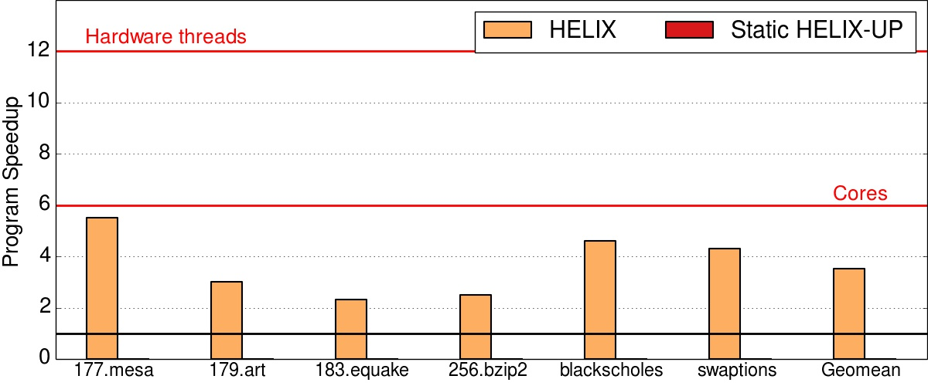
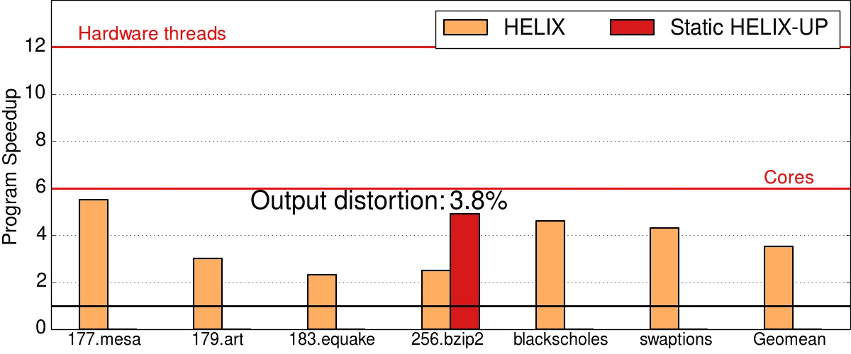
HELIX: no relaxing transformations
HELIX-UP unblocks extra parallelism with small output distortions
Nehalem 6 cores
2 threads per core

Slide 36
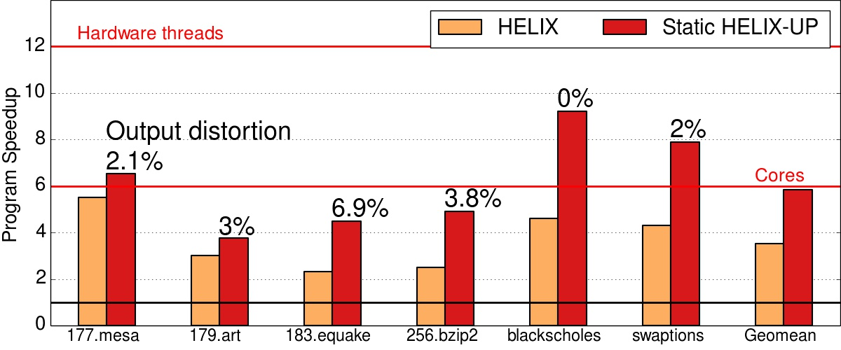
HELIX-UP unblocks extra parallelism with small output distortions
Nehalem 6 cores
2 threads per core

Slide 37
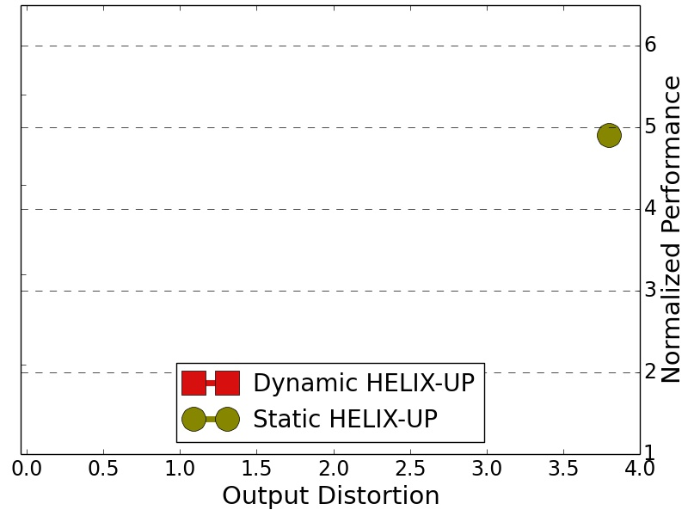
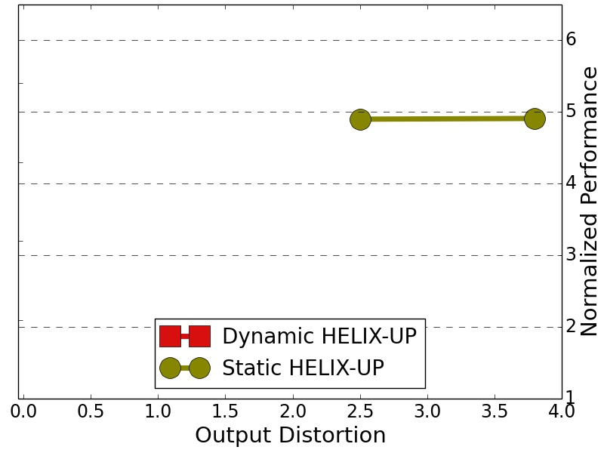
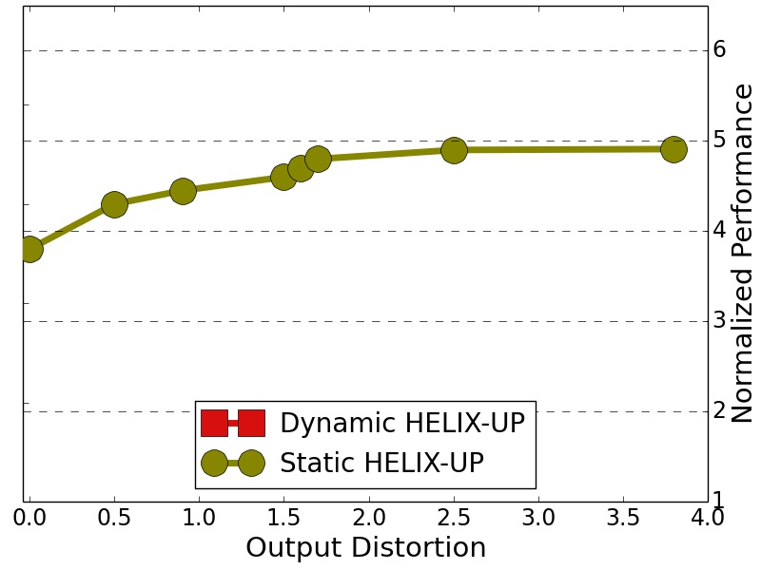
Performance/distortion tradeoff
256.bzip2
HELIX
%

Slide 38
Run time code tuning
Static HELIX-UP decides how to transform the code based on profile data averaged over inputs
The runtime reacts to transient bottlenecks by adjusting code accordingly

Slide 39
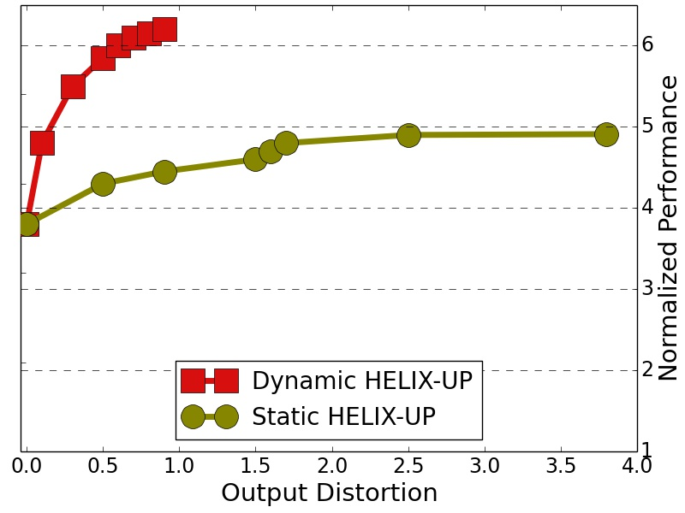
Adapting code at run time unlocks more parallelism
256.bzip2
HELIX
%

Slide 40
HELIX-UP improves more than just performance
Robustness to DDG inaccuracies
Consistent performance across platforms

Slide 41
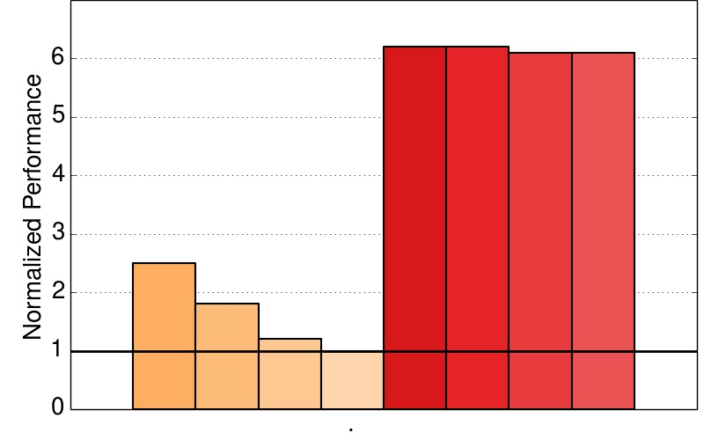
Relaxed transformations to be robust to DDG inaccuracies
256.bzip2
Increasing DDG inaccuracies leads to lower performance
No impact on HELIX-UP
HELIX
HELIX-UP

Slide 42
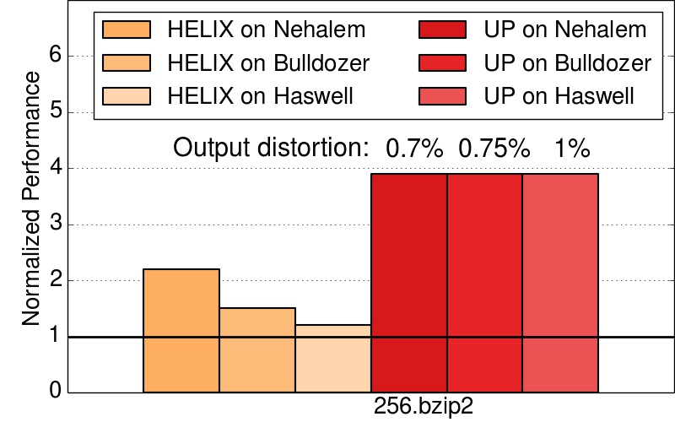
Relaxed transformations for consistent performance
Increasing communication latency

Slide 43
So, what’s next?

Slide 44

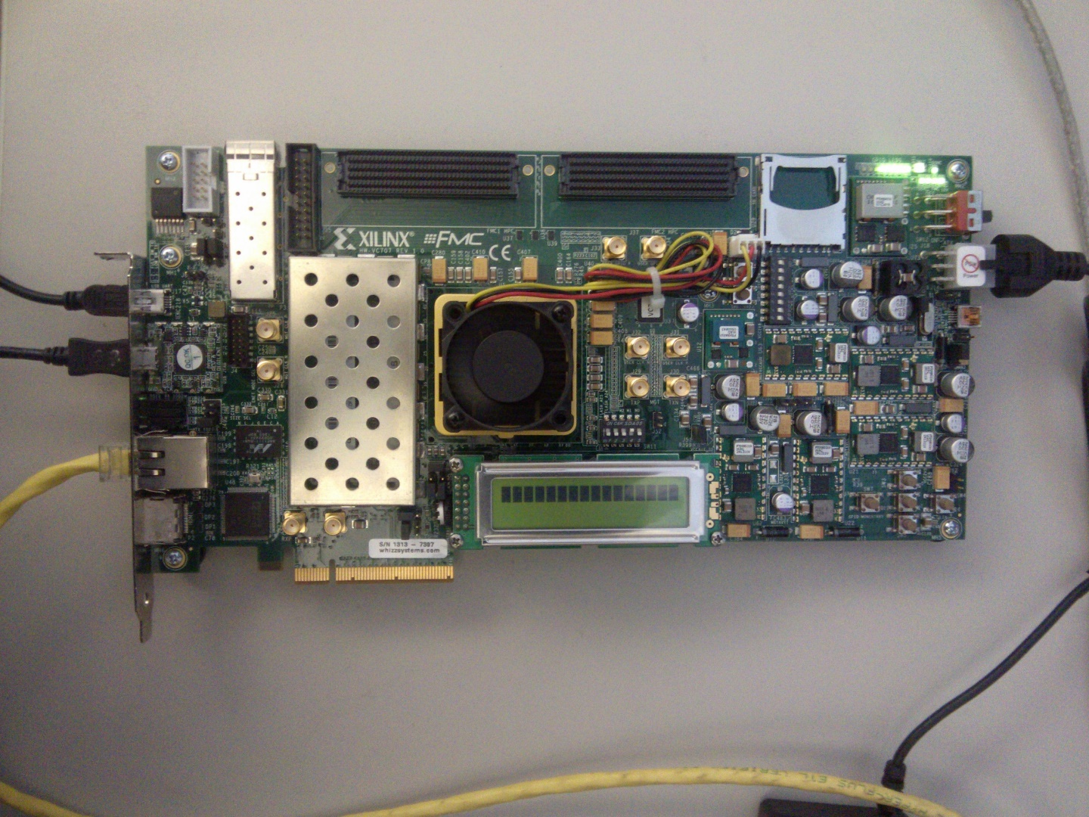





Next work
Real system evaluation of HELIX-RC
Multi programs scenario
Speculation for SLP

Slide 45
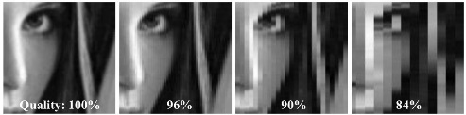
Small Loop Parallelism and HELIX
Parallelism hides in small loops
HELIX-RC: Architecture/Compiler Co-Design
Irregular programs require low latency
HELIX-UP: Unleash Parallelization
Tolerating distortions boosts parallelization

Slide 46
Thank you!

Slide 47
Small Loop Parallelism and HELIX
Parallelism hides in small loops
HELIX-RC: Architecture/Compiler Co-Design
Irregular programs require low latency
HELIX-UP: Unleash Parallelization
Tolerating distortions boosts parallelization

Slide 48


Slide 49




Future work: application-specific
Programming language
Future work
Compiler
My contribution
Architecture
Parallelism
Communication
HW/compiler interface
Circuit

Slide 50
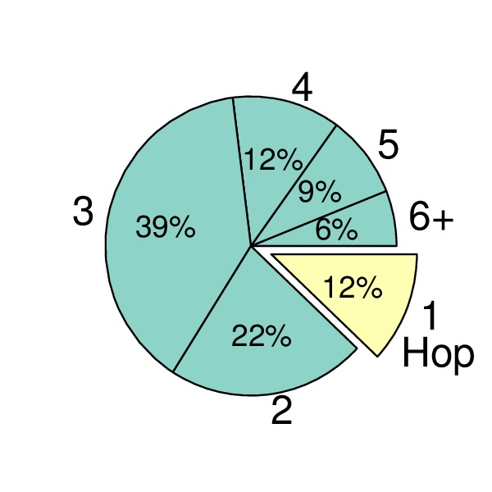
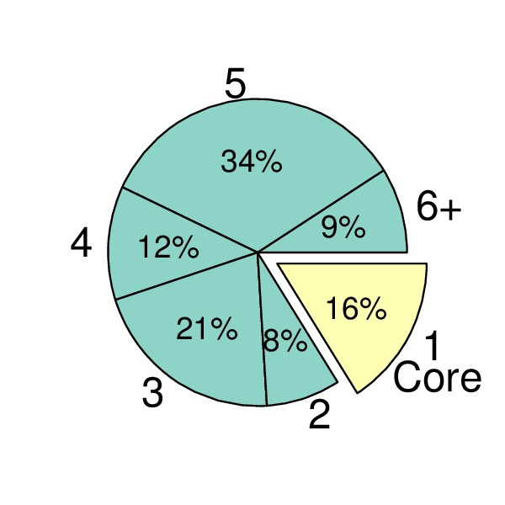
Irregular data consumption
Distance of consumers
Number of consumers
Proactively broadcast shared data

Slide 51
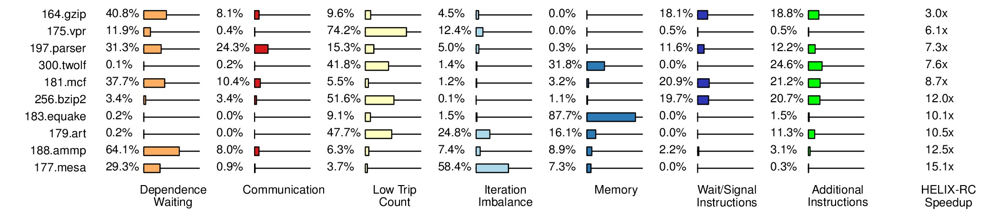
Breakdown of overhead left

Slide 52
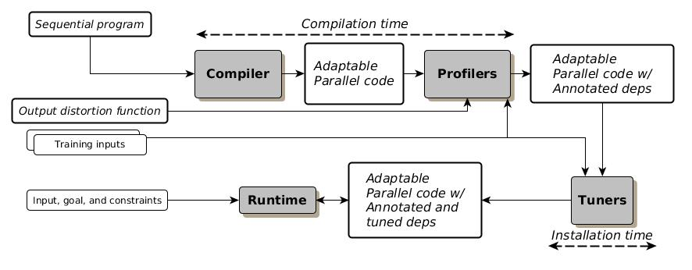
How to adapt code?
Which code to adapt?
When to adapt code?

Slide 53
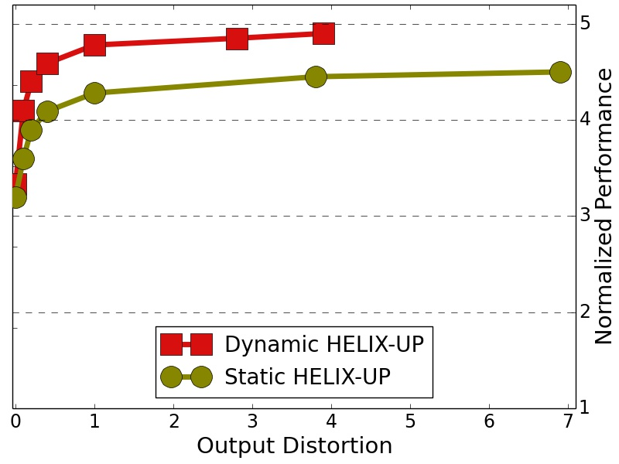
Setting knobs statically is good enough for regular workload
183.equake
HELIX
%

Slide 54
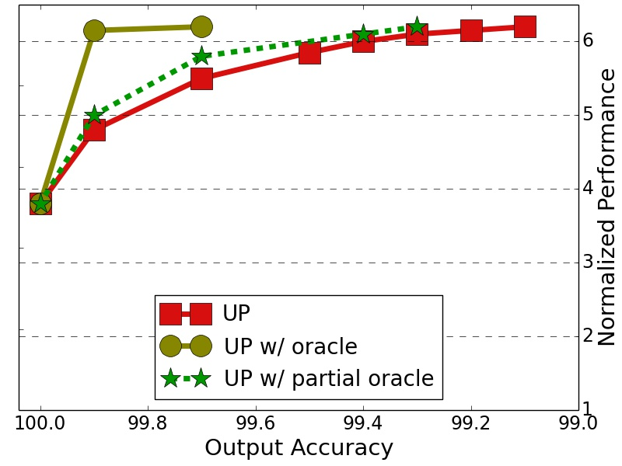
HELIX-UP runtime is “good enough”
256.bzip2

Slide 55
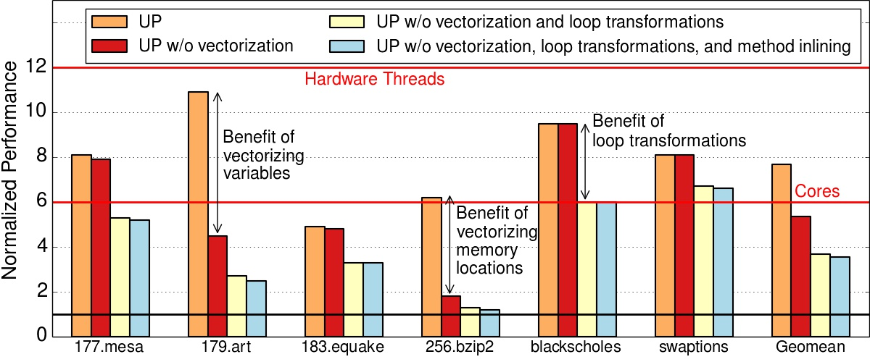
Conventional transformations are still important

Slide 56
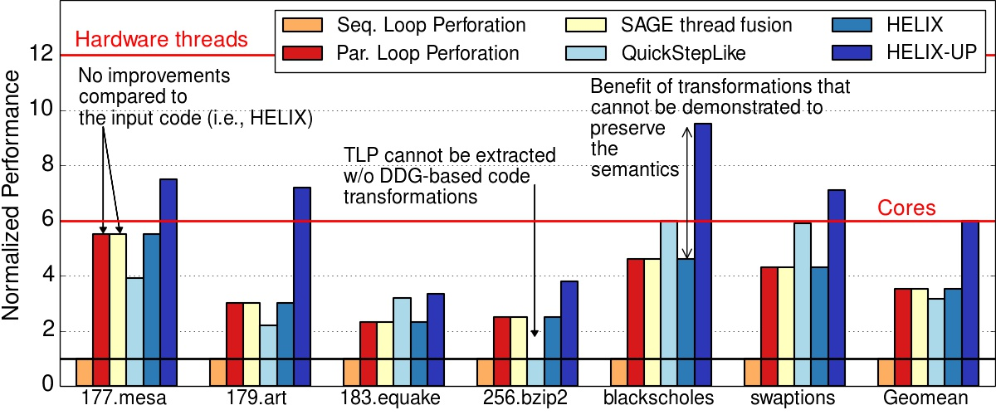
HELIX-UP and Related Work with no output distortion

Slide 57
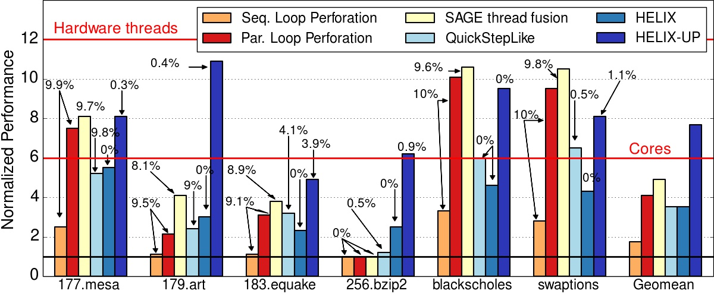
HELIX-UP and Related Work with output distortion

Slide 58

Relaxed transformations remove performance bottlenecks
Sequential bottleneck
A code region executed sequentially
No output distortion Baseline performance
Max output distortion Max performance
A knob for each sequential code region

Slide 59
Small Loop Parallelism: a compiler-level granularity
Frequency of communication
Granularity
Coarse grain
Programming language
TLP
Compiler
SLP
Architecture
ILP
Circuit
Frequent

Slide 60
The HELIX flow
We’ve made many enhancements to existing code analysis,
e.g., DDG, induction variables, etc.

Slide 61
Sims show single-cycle latency is possible for adjacent-core communication

Slide 62
Simulator overview and accuracy
Workload
(parallel x86)
Un-core
Pin
VM
Core
RC
Host /
OS

Slide 63
Brief description of SPEC2K benchmarks used in our experiments
Non-numerical
Numerical
gzip & bzip2
compression
vpr & twolf
place & route CAD
parser
Syntactic parser of English
XML?
mcf
Combinatorial optimization; network flow, scheduling
art
Neural network simulation; image recognition; machine learning
equake
Seismic wave propagation
mesa
Emulates graphics on CPU
ammp
Computational chemistry (e.g., atoms moving)

Slide 64
Characteristics of parallelized benchmarks
HELIX+RC

